Slide 1
Wild Plants Edibility Prediction Using IBM Watson Studio
PRESENTED BY:
TEAM NO: CSE-007
18UK1A0534 - Muppala Keerthana
18UK1A0556 - Bourishetty Swetha
18UK1A0538- Kaleru Naresh
18UK1A0507 – Bhukya Santhosh

Slide 2
OUTLINE
INTRODUCTION
OBJECTIVE
DATA
PROJECT FLOW
PREREQUISITES
DEEP LEARNING ALGORITHM
MODEL BUILDING
SOFTWARE REQUIREMENTS
FUTURE SCOPE
CONCLUSION

Slide 3
INTRODUCTION
The rural communities of developing countries depend on wild edible plants to meet their food requirements during periods of food shortage. Wild edible plants are mostly serving as supplementary foods in different parts of the world because they are nutritionally rich and can supplement especially vitamins and micronutrients. The main objective of this project is to build Convolutional neural networks are a deep model to detect and classify the edibility of the wild plant. The model also suggests the effects of non-edible wild plant produce.
We are creating a web application where the user selects the image which is to be classified. The image is fed into the model that is trained and the predicted class will be displayed on the webpage.

Slide 4
OBJECTIVE
know fundamental concepts and techniques of the Artificial Neural Network and Convolution Neural Networks
Gain a broad understanding of image data.
Work with Sequential type of modeling
Work with Keras capabilities
Work with image processing techniques
know how to build a web application using the Flask framework.

Slide 5
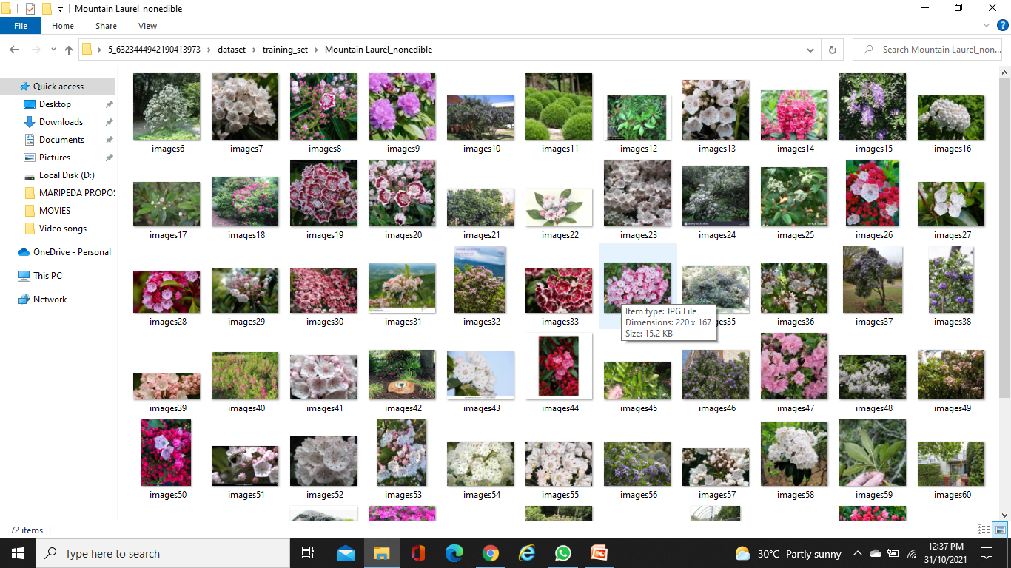
DATA
Wild Plants Edibility Prediction consists of:
The dataset contains six classes:
Mountain Laurel_nonedible Peppergrass_edible
Purple Deadnettle_edible 'Rhododendron_nonedible’,
Toothwort_edible
'Wild Grape Vine_edible’,
Wild Leek_edible
rattlebox_nonedible

Slide 6
PROJECT FLOW:
Data Collection.
Collect the dataset or Create the dataset
Data Preprocessing.
Import the ImageDataGenerator library
Configure ImageDataGenerator class
Apply ImageDataGenerator functionality to Trainset and Testset
Model Building
Import the model building Libraries
Initializing the model
Adding Input Layer
Adding Hidden Layer
Adding Output Layer
Configure the Learning Process
Training and testing the model
Optimize the Model
Save the Model
Application Building
Create an HTML file
Build Python Code

Slide 7
PREREQUISITES:
To complete this project we required the following software and packages
Anaconda Navigator :
Anaconda Navigator is a free and open-source distribution of the Python and R programming languages for data science and machine learning related applications. It can be installed on Windows, Linux, and macOS.Conda is an open-source, cross-platform, package management system. Anaconda comes with so very nice tools like JupyterLab, Jupyter Notebook,
QtConsole, Spyder, Glueviz, Orange, Rstudio, Visual Studio Code. For this project, we used Jupiter notebook and spyder
To complete this project you installed the following software and packages :
Tensor flow: TensorFlow is an end-to-end open-source platform for machine learning. It has a comprehensive, flexible ecosystem of tools, libraries, and community resources that lets researchers push the state-of-the-art in ML and developers can easily build and deploy ML powered applications.
Keras : Keras leverages various optimization techniques to make high level neural network API easier and more performant.
Flask: Web frame work used for building Web applications.

Slide 8
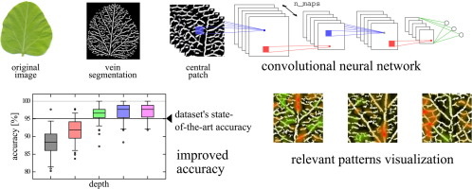
DEEP LEARNING ALGORITHM
Convolutional Neural Networks
A convolutional neural network (CNN) is a type of artificial neural networks used in image recognition and processing that is specifically designed to process pixel data.
CNNs are powerful image processing, artificial intelligence (AI) that use deep learning to perform both generative and descriptive tasks. A CNN uses a system much like a multilayer perceptron that has been designed for reduced processing requirements. The layers of a CNN consist of an input layer, an output layer and a hidden layer that includes multiple convolutional layers, pooling layers, fully connected layers and normalization layers.

Slide 9
SOFTWARE REQUIREMENTS
Anaconda navigator
Jupyter notebook
Jupiter spyder
Deep learning Tools: pandas,
NumPy,
Tensor flow,
Keras,

Slide 10
Future scope:
Wild plants are serving as supplementary foods for various rural communities.
The model built with convolution neural networks detect and classifying edibility of wild plants.
Our model also suggests the effects of non-edible wild plant procedure.

Slide 11
CONCLUSION
In this project we have presented the Wild Plants Edibility Prediction
We have done the Prediction using Deep Learning Techniques.
We are creating a web application where the user selects the image which is to be classified. The image is fed into the model that is trained and the predicted class will be displayed on the webpage.

Slide 12
